Slide 1
Appendix I – Elevator View
Outline
I.1 Introduction
I.2 Class Objects
I.3 Class Constants
I.4 Class Constructor
I.5 Event Handling
I.6 Component Diagrams Revisited

Slide 2
I.1 Introduction
Class ElevatorView
  Graphical representation of elevator-simulation model
  Largest class in case study

Slide 3
Fig.I.1
ElevatorView displays the elevator simulation model.
Lines 18-20
Lines 23-24
Line 30
1 // ElevatorView.java
2 // View for ElevatorSimulation
3 package com.deitel.jhtp4.elevator.view;
4
5 // Java core packages
6 import java.awt.*;
7 import java.awt.event.*;
8 import java.util.*;
9 import java.applet.*;
10
11 // Java extension package
12 import javax.swing.*;
13
14 // Deitel packages
15 import com.deitel.jhtp4.elevator.event.*;
16 import com.deitel.jhtp4.elevator.ElevatorConstants;
17
18 public class ElevatorView extends JPanel
19 implements ActionListener, ElevatorModelListener,
20 ElevatorConstants {
21
22 // ElevatorView dimensions
23 private static final int VIEW_WIDTH = 800;
24 private static final int VIEW_HEIGHT = 435;
25
26 // offset for positioning Panels in ElevatorView
27 private static final int OFFSET = 10;
28
29 // Elevator repaints components every 50 ms
30 private static final int ANIMATION_DELAY = 50;
31
ElevatorView implements ElevatorModelListener, which inherits from all listener interfaces
Constants for width and height of ElevatorView
Constant for animation (refresh) rate

Slide 4
Fig.I.1
ElevatorView displays the elevator simulation model (Part 2).
Lines 33-36
Lines 39-40
Line 43
Lines 46-63
32 // horizontal distance constants
33 private static final int PERSON_TO_BUTTON_DISTANCE = 400;
34 private static final int BUTTON_TO_ELEVATOR_DISTANCE = 50;
35 private static final int PERSON_TO_ELEVATOR_DISTANCE =
36 PERSON_TO_BUTTON_DISTANCE + BUTTON_TO_ELEVATOR_DISTANCE;
37
38 // times walking to Floor's Button and Elevator
39 private static final int TIME_TO_BUTTON = 3000; // 3 seconds
40 private static final int TIME_TO_ELEVATOR = 1000; // 1 second
41
42 // time traveling in Elevator (5 seconds)
43 private static final int ELEVATOR_TRAVEL_TIME = 5000;
44
45 // Door images for animation
46 private static final String doorFrames[] = {
47 "images/door1.png", "images/door2.png", "images/door3.png",
48 "images/door4.png", "images/door5.png" };
49
50 // Person images for animation
51 private static final String personFrames[] = {
52 "images/bug1.png", "images/bug2.png", "images/bug3.png",
53 "images/bug4.png", "images/bug5.png", "images/bug6.png",
54 "images/bug7.png", "images/bug8.png" };
55
56 // Light images for animation
57 private static final String lightFrames[] = {
58 "images/lightOff.png", "images/lightOn.png" };
59
60 // Floor Light images for animation
61 private static final String firstFloorLightFrames[] = {
62 "images/firstFloorLightOff.png",
63 "images/firstFloorLightOn.png" };
64
Constants for distances that Person must travel
Constants for time requires to travel distances that Person must travel
Constant for time required to travel between Floors
Constants for names of graphics files for Door, Person and Light

Slide 5
Fig.I.1
ElevatorView displays the elevator simulation model (Part 3).
Lines 65-95
Lines 88-89,
Lines 92-93
65 private static final String secondFloorLightFrames[] = {
66 "images/secondFloorLightOff.png",
67 "images/secondFloorLightOn.png", };
68
69 // Floor Button images for animation
70 private static final String floorButtonFrames[] = {
71 "images/floorButtonUnpressed.png",
72 "images/floorButtonPressed.png",
73 "images/floorButtonLit.png" };
74
75 // Elevator Button images for animation
76 private static final String elevatorButtonFrames[] = {
77 "images/elevatorButtonUnpressed.png",
78 "images/elevatorButtonPressed.png",
79 "images/elevatorButtonLit.png" };
80
81 // Bell images for animation
82 private static final String bellFrames[] = {
83 "images/bell1.png", "images/bell2.png",
84 "images/bell3.png" };
85
86 private static final String floorImage =
87 "images/floor.png";
88 private static final String ceilingImage =
89 "images/ceiling.png";
90 private static final String elevatorImage =
91 "images/elevator.png";
92 private static final String wallImage =
93 "images/wall.jpg";
94 private static final String elevatorShaftImage =
95 "images/elevatorShaft.png";
96
Constants for names of graphics files for Light, Button , Bell, Floor, Elevator and ElevatorShaft
Ceiling and wall are not in model, but we display them for realism

Slide 6
Fig.I.1
ElevatorView displays the elevator simulation model (Part 4).
Lines 98-103
Line 105
Lines 108-112
Line 115
Lines 118-125
Line 128
97 // audio files
98 private static final String bellSound = "bell.wav";
99 private static final String doorOpenSound = "doorOpen.wav";
100 private static final String doorCloseSound = "doorClose.wav";
101 private static final String elevatorSound = "elevator.au";
102 private static final String buttonSound = "button.wav";
103 private static final String walkingSound = "walk.wav";
104
105 private static final String midiFile = "sounds/liszt.mid";
106
107 // ImagePanels for Floors, ElevatorShaft, wall and ceiling
108 private ImagePanel firstFloorPanel;
109 private ImagePanel secondFloorPanel;
110 private ImagePanel elevatorShaftPanel;
111 private ImagePanel wallPanel;
112 private ImagePanel ceilingPanel;
113
114 // MovingPanels for Elevator
115 private MovingPanel elevatorPanel;
116
117 // AnimatedPanels for Buttons, Bell, Lights and Door
118 private AnimatedPanel firstFloorButtonPanel;
119 private AnimatedPanel secondFloorButtonPanel;
120 private AnimatedPanel elevatorButtonPanel;
121 private AnimatedPanel bellPanel;
122 private AnimatedPanel elevatorLightPanel;
123 private AnimatedPanel firstFloorLightPanel;
124 private AnimatedPanel secondFloorLightPanel;
125 private AnimatedPanel doorPanel;
126
127 // List containing AnimatedPanels for all Person objects
128 private java.util.List personAnimatedPanels;
129
Constants for names of sound-clip files
Constant for name of “elevator music” file
ImagePanels represent stationary objects in model (e.g., Floor, ElevatorShaft)
MovingPanels represent objects that can move and have one only associated image (e.g., Elevator)
AnimatedPanels represent objects in model with multiple images (e.g., Button, Person, Light, Bell and Door)
List stores AnimatedPanels associated with Persons

Slide 7
Fig.I.1
ElevatorView displays the elevator simulation model (Part 5).
Lines 131-136
Line 139
Line 142
Line 155
130 // AudioClips for sound effects
131 private AudioClip bellClip;
132 private AudioClip doorOpenClip;
133 private AudioClip doorCloseClip;
134 private AudioClip elevatorClip;
135 private AudioClip buttonClip;
136 private AudioClip walkClip;
137
138 // ElevatorMusic to play in Elevator
139 private ElevatorMusic elevatorMusic;
140
141 // Timer for animation controller;
142 private javax.swing.Timer animationTimer;
143
144 // distance from top of screen to display Floors
145 private int firstFloorPosition;
146 private int secondFloorPosition;
147
148 // Elevator's velocity
149 private double elevatorVelocity;
150
151 // ElevatorView constructor
152 public ElevatorView()
153 {
154 // specify null Layout
155 super( null );
156
157 instantiatePanels();
158 placePanelsOnView();
159 initializeAudio();
160
161 // calculate distance Elevator travels
162 double floorDistance =
163 firstFloorPosition - secondFloorPosition;
164
AudioClips for playing sound clips
ElevatorMusic plays music when Person rides Elevator
Timer determines when to redraw images
Using null layout allows us to display images anywhere on ElevatorView

Slide 8
Fig.I.1
ElevatorView displays the elevator simulation model (Part 6).
Lines 166-169
Line 172
Lines 180-181
Line 192
Lines 195-196
165 // calculate time needed for travel
166 double time = ELEVATOR_TRAVEL_TIME / ANIMATION_DELAY;
167
168 // determine Elevator velocity (rate = distance / time)
169 elevatorVelocity = ( floorDistance + OFFSET ) / time;
170
171 // start animation Thread
172 startAnimation();
173
174 } // end ElevatorView constructor
175
176 // instantiate all Panels (Floors, Elevator, etc.)
177 private void instantiatePanels()
178 {
179 // instantiate ImagePanels representing Floors
180 firstFloorPanel = new ImagePanel( 0, floorImage );
181 secondFloorPanel = new ImagePanel( 0, floorImage );
182
183 // calculate first and second Floor positions
184 firstFloorPosition =
185 VIEW_HEIGHT - firstFloorPanel.getHeight();
186 secondFloorPosition =
187 ( int ) ( firstFloorPosition / 2 ) - OFFSET;
188
189 firstFloorPanel.setPosition( 0, firstFloorPosition );
190 secondFloorPanel.setPosition( 0, secondFloorPosition );
191
192 wallPanel = new ImagePanel( 0, wallImage );
193
194 // create and position ImagePanel for ElevatorShaft
195 elevatorShaftPanel =
196 new ImagePanel( 0, elevatorShaftImage );
197
Calculate velocity used by Elevator’s ImagePanel
Starting Timer starts animation
Instantiate ImagePanels for Floors
Instantiate ImagePanel for wall (not used in model)
Instantiate ImagePanel for ElevatorShaft

Slide 9
Fig.I.1
ElevatorView displays the elevator simulation model (Part 7).
Line 205
Line 213
Lines 220-221
Lines 227-229
198 double xPosition = PERSON_TO_ELEVATOR_DISTANCE + OFFSET;
199 double yPosition =
200 firstFloorPosition - elevatorShaftPanel.getHeight();
201
202 elevatorShaftPanel.setPosition( xPosition, yPosition );
203
204 // create and position ImagePanel for ceiling
205 ceilingPanel = new ImagePanel( 0, ceilingImage );
206
207 yPosition = elevatorShaftPanel.getPosition().getY() -
208 ceilingPanel.getHeight();
209
210 ceilingPanel.setPosition( xPosition, yPosition );
211
212 // create and position MovingPanel for Elevator
213 elevatorPanel = new MovingPanel( 0, elevatorImage );
214
215 yPosition = firstFloorPosition - elevatorPanel.getHeight();
216
217 elevatorPanel.setPosition( xPosition, yPosition );
218
219 // create and position first Floor Button
220 firstFloorButtonPanel =
221 new AnimatedPanel( 0, floorButtonFrames );
222
223 xPosition = PERSON_TO_BUTTON_DISTANCE + 2 * OFFSET;
224 yPosition = firstFloorPosition - 5 * OFFSET;
225 firstFloorButtonPanel.setPosition( xPosition, yPosition );
226
227 int floorButtonPressedFrameOrder[] = { 0, 1, 2 };
228 firstFloorButtonPanel.addFrameSequence(
229 floorButtonPressedFrameOrder );
230
Instantiate ImagePanel for ceiling (not used in model)
Instantiate MovingPanel for Elevator
Instantiate AnimatedPanel for Button on first Floor
AnimatedPanels use int arrays that determines their image sequences

Slide 10
Fig.I.1
ElevatorView displays the elevator simulation model (Part 8).
Lines 232-233
Lines 243-245
Lines 251-252
Line 259
231 // create and position second Floor Button
232 secondFloorButtonPanel =
233 new AnimatedPanel( 1, floorButtonFrames );
234
235 xPosition = PERSON_TO_BUTTON_DISTANCE + 2 * OFFSET;
236 yPosition = secondFloorPosition - 5 * OFFSET;
237 secondFloorButtonPanel.setPosition( xPosition, yPosition );
238
239 secondFloorButtonPanel.addFrameSequence(
240 floorButtonPressedFrameOrder );
241
242 // create and position Floor Lights
243 firstFloorLightPanel =
244 new AnimatedPanel( 0, firstFloorLightFrames );
245
246 xPosition = elevatorPanel.getLocation().x - 4 * OFFSET;
247 yPosition =
248 firstFloorButtonPanel.getLocation().y - 10 * OFFSET;
249 firstFloorLightPanel.setPosition( xPosition, yPosition );
250
251 secondFloorLightPanel =
252 new AnimatedPanel( 1, secondFloorLightFrames );
253
254 yPosition =
255 secondFloorButtonPanel.getLocation().y - 10 * OFFSET;
256 secondFloorLightPanel.setPosition( xPosition, yPosition );
257
258 // create and position Door AnimatedPanels
259 doorPanel = new AnimatedPanel( 0, doorFrames );
260 int doorOpenedFrameOrder[] = { 0, 1, 2, 3, 4 };
261 int doorClosedFrameOrder[] = { 4, 3, 2, 1, 0 };
262 doorPanel.addFrameSequence( doorOpenedFrameOrder );
263 doorPanel.addFrameSequence( doorClosedFrameOrder );
264
Instantiate AnimatedPanel for Button on second Floor
Instantiate AnimatedPanel for Light on first Floor
Instantiate AnimatedPanel for Light on second Floor
Instantiate AnimatedPanel for Door in Elevator (Note: we do not show Doors on Floors, because they would obscure Person when riding Elevator)

Slide 11
Fig.I.1
ElevatorView displays the elevator simulation model (Part 9).
Line 272
Line 276
Lines 286-287
Line 297
265 // determine where Door is located relative to Elevator
266 yPosition =
267 elevatorPanel.getHeight() - doorPanel.getHeight();
268
269 doorPanel.setPosition( 0, yPosition );
270
271 // create and position Light AnimatedPanel
272 elevatorLightPanel = new AnimatedPanel( 0, lightFrames );
273 elevatorLightPanel.setPosition( OFFSET, 5 * OFFSET );
274
275 // create and position Bell AnimatedPanel
276 bellPanel = new AnimatedPanel( 0, bellFrames );
277
278 yPosition = elevatorLightPanel.getPosition().getY() +
279 elevatorLightPanel.getHeight() + OFFSET;
280
281 bellPanel.setPosition( OFFSET, yPosition );
282 int bellRingAnimation[] = { 0, 1, 0, 2 };
283 bellPanel.addFrameSequence( bellRingAnimation );
284
285 // create and position Elevator's Button AnimatedPanel
286 elevatorButtonPanel =
287 new AnimatedPanel( 0, elevatorButtonFrames );
288
289 yPosition = elevatorPanel.getHeight() - 6 * OFFSET;
290 elevatorButtonPanel.setPosition( 10 * OFFSET, yPosition );
291
292 int buttonPressedFrameOrder[] = { 0, 1, 2 };
293 elevatorButtonPanel.addFrameSequence(
294 buttonPressedFrameOrder );
295
296 // create List to store Person AnimatedPanels
297 personAnimatedPanels = new ArrayList();
298
299 } // end method instantiatePanels
Instantiate AnimatedPanel for Light inside Elevator
Instantiate AnimatedPanel for Bell inside Elevator
Instantiate AnimatedPanel for Button inside Elevator
Instantiate ArrayList to store references to AnimatedPanel’s associated with Person’s

Slide 12
Fig.I.1
ElevatorView displays the elevator simulation model (Part 10).
Lines 305-314
Lines 317-320
Line 328
300
301 // place all Panels on ElevatorView
302 private void placePanelsOnView()
303 {
304 // add Panels to ElevatorView
305 add( firstFloorPanel );
306 add( secondFloorPanel );
307 add( ceilingPanel );
308 add( elevatorPanel );
309 add( firstFloorButtonPanel );
310 add( secondFloorButtonPanel );
311 add( firstFloorLightPanel );
312 add( secondFloorLightPanel );
313 add( elevatorShaftPanel );
314 add( wallPanel );
315
316 // add Panels to Elevator's MovingPanel
317 elevatorPanel.add( doorPanel );
318 elevatorPanel.add( elevatorLightPanel );
319 elevatorPanel.add( bellPanel );
320 elevatorPanel.add( elevatorButtonPanel );
321
322 } // end method placePanelsOnView
323
324 // get sound effects and elevatorMusic
325 private void initializeAudio()
326 {
327 // create AudioClip sound effects from audio files
328 SoundEffects sounds = new SoundEffects();
329 sounds.setPathPrefix( "sounds/" );
330
Add ImagePanels to ElevatorView
Add ImagePanels for elevator’s door, light bell and button to the ImagePanel associated with Elevator
SoundEffects object creates AudioClips that play sound clips

Slide 13
Fig.I.1
ElevatorView displays the elevator simulation model (Part 11).
Lines 331-336
Lines 339-340
Lines 345-356
Lines 359-362
331 bellClip = sounds.getAudioClip( bellSound );
332 doorOpenClip = sounds.getAudioClip( doorOpenSound );
333 doorCloseClip = sounds.getAudioClip( doorCloseSound );
334 elevatorClip = sounds.getAudioClip( elevatorSound );
335 buttonClip = sounds.getAudioClip( buttonSound );
336 walkClip = sounds.getAudioClip( walkingSound );
337
338 // create MIDI player using Java Media Framework
339 elevatorMusic = new ElevatorMusic( midiFile );
340 elevatorMusic.open();
341
342 } // end method initializeAudio
343
344 // starts animation by repeatedly drawing images to screen
345 public void startAnimation()
346 {
347 if ( animationTimer == null ) {
348 animationTimer =
349 new javax.swing.Timer( ANIMATION_DELAY, this );
350 animationTimer.start();
351 }
352 else
353
354 if ( !animationTimer.isRunning() )
355 animationTimer.restart();
356 }
357
358 // stop animation
359 public void stopAnimation()
360 {
361 animationTimer.stop();
362 }
363
Use SoundEffects object to obtain references to AudioClips
ElevatorMusic object open MIDI player for specified MIDI file (“elevator music”)
Method startAnimation starts Timer, which starts animation
Method stopAnimation stops Timer, which stops animation

Slide 14
Fig.I.1
ElevatorView displays the elevator simulation model (Part 12).
Lines 365-385
Lines 367-380
Lines 387-394
364 // update AnimatedPanels animation in response to Timer
365 public void actionPerformed( ActionEvent actionEvent )
366 {
367 elevatorPanel.animate();
368
369 firstFloorButtonPanel.animate();
370 secondFloorButtonPanel.animate();
371
372 Iterator iterator = getPersonAnimatedPanelsIterator();
373
374 while ( iterator.hasNext() ) {
375
376 // get Person's AnimatedPanel from Set
377 AnimatedPanel personPanel =
378 ( AnimatedPanel ) iterator.next();
379
380 personPanel.animate(); // update panel
381 }
382
383 repaint(); // paint all Components
384
385 } // end method actionPerformed
386
387 private Iterator getPersonAnimatedPanelsIterator()
388 {
389 // obtain iterator from List
390 synchronized( personAnimatedPanels )
391 {
392 return new ArrayList( personAnimatedPanels ).iterator();
393 }
394 }
395
Timer invokes method actionPerformed every 50 (ANIMATION_DELAY) milliseconds
Animate ImagePanels for Elevator, Buttons and Persons
Obtain the Iterator of the ArrayList of (Person) AnimatedPanel

Slide 15
Fig.I.1
ElevatorView displays the elevator simulation model (Part 13).
Lines 397-411
Lines 405-410
Lines 414-432
396 // stop sound clip of Person walking
397 private void stopWalkingSound()
398 {
399 // stop playing walking sound
400 walkClip.stop();
401
402 Iterator iterator = getPersonAnimatedPanelsIterator();
403
404 // but if Person is still walking, then keep playing
405 while ( iterator.hasNext() ) {
406 AnimatedPanel panel = ( AnimatedPanel ) iterator.next();
407
408 if ( panel.getXVelocity() != 0 )
409 walkClip.loop();
410 }
411 } // end method stopWalkingSound
412
413 // returns Person AnimatedPanel with proper identifier
414 private AnimatedPanel getPersonPanel( PersonMoveEvent event )
415 {
416 Iterator iterator = getPersonAnimatedPanelsIterator();
417
418 while ( iterator.hasNext() ) {
419
420 // get next AnimatedPanel
421 AnimatedPanel personPanel =
422 ( AnimatedPanel ) iterator.next();
423
424 // return AnimatedPanel with identifier that matches
425 if ( personPanel.getID() == event.getID() )
426 return personPanel;
427 }
428
429 // return null if no match with correct identifier
430 return null;
Stop sound clip played by Elevator-View when a Person walks
If a Person is still walking, continue the sound clip
Obtain AnimatedPanel associated with Person that sent the PersonMoveEvent

Slide 16
Fig.I.1
ElevatorView displays the elevator simulation model (Part 14).
Line 435
Lines 448-462
431
432 } // end method getPersonPanel
433
434 // invoked when Elevator has departed from Floor
435 public void elevatorDeparted( ElevatorMoveEvent moveEvent )
436 {
437 String location =
438 moveEvent.getLocation().getLocationName();
439
440 // determine if Person is on Elevator
441 Iterator iterator = getPersonAnimatedPanelsIterator();
442
443 while ( iterator.hasNext() ) {
444
445 AnimatedPanel personPanel =
446 ( AnimatedPanel ) iterator.next();
447
448 double yPosition = personPanel.getPosition().getY();
449 String panelLocation;
450
451 // determine on which Floor the Person entered
452 if ( yPosition > secondFloorPosition )
453 panelLocation = FIRST_FLOOR_NAME;
454 else
455 panelLocation = SECOND_FLOOR_NAME;
456
457 int xPosition =
458 ( int ) personPanel.getPosition().getX();
459
460 // if Person is inside Elevator
461 if ( panelLocation.equals( location )
462 && xPosition > PERSON_TO_BUTTON_DISTANCE + OFFSET ) {
463
Invoked when Elevator has departed from Floor
Determine whether Person is riding Elevator

Slide 17
Fig.I.1
ElevatorView displays the elevator simulation model (Part 15).
Lines 465-473
Lines 478-483
Lines 486-491
464 // remove Person AnimatedPanel from ElevatorView
465 remove( personPanel );
466
467 // add Person AnimatedPanel to Elevator
468 elevatorPanel.add( personPanel, 1 );
469 personPanel.setLocation( 2 * OFFSET, 9 * OFFSET );
470 personPanel.setMoving( false );
471 personPanel.setAnimating( false );
472 personPanel.setVelocity( 0, 0 );
473 personPanel.setCurrentFrame( 1 );
474 }
475 } // end while loop
476
477 // determine Elevator velocity depending on Floor
478 if ( location.equals( FIRST_FLOOR_NAME ) )
479 elevatorPanel.setVelocity( 0, -elevatorVelocity );
480 else
481
482 if ( location.equals( SECOND_FLOOR_NAME ) )
483 elevatorPanel.setVelocity( 0, elevatorVelocity );
484
485 // begin moving Elevator and play Elevator music
486 elevatorPanel.setMoving( true );
487
488 if ( elevatorClip != null )
489 elevatorClip.play();
490
491 elevatorMusic.play();
492
493 } // end method elevatorDeparted
494
495 // invoked when Elevator has arrived at destination Floor
If Person is riding Elevator, remove Person from Elevator-View and add Person to Elevator
Determine direction Elevator should travel
Set Elevator to moving state, then play sound effect and music associated with the Elevator’s movement

Slide 18
Fig.I.1
ElevatorView displays the elevator simulation model (Part 16).
Line 496
Lines 499-500
Lines 506-511
Line 518
Lines 520-523
Lines 526-627
496 public void elevatorArrived( ElevatorMoveEvent moveEvent )
497 {
498 // stop Elevator and music
499 elevatorPanel.setMoving( false );
500 elevatorMusic.getSequencer().stop();
501
502 double xPosition = elevatorPanel.getPosition().getX();
503 double yPosition;
504
505 // set Elevator's position to either first or second Floor
506 if ( elevatorPanel.getYVelocity() < 0 )
507 yPosition =
508 secondFloorPosition - elevatorPanel.getHeight();
509 else
510 yPosition =
511 firstFloorPosition - elevatorPanel.getHeight();
512
513 elevatorPanel.setPosition( xPosition, yPosition );
514
515 } // end method elevatorArrived
516
517 // invoked when Person has been created in model
518 public void personCreated( PersonMoveEvent personEvent )
519 {
520 int personID = personEvent.getID();
521
522 String floorLocation =
523 personEvent.getLocation().getLocationName();
524
525 // create AnimatedPanel representing Person
526 AnimatedPanel personPanel =
527 new AnimatedPanel( personID, personFrames );
528
Invoked when Elevator has arrived at Floor
Set Elevator to waiting state and stop music associated with the Elevator’s movement
Set Elevator’s y-coordinate to that of the Floor on which the Elevator arrived
Invoked when user creates Person in simulation
Determine which Person was created and on what Floor
Create AnimatedPanel to represent Person in view

Slide 19
Fig.I.1
ElevatorView displays the elevator simulation model (Part 17).
Lines 531-545
Lines 548-553
Lines 556-559
529 // determine where Person should be drawn initially
530 // negative xPosition ensures Person drawn offscreen
531 double xPosition = - personPanel.getWidth();
532 double yPosition = 0;
533
534 if ( floorLocation.equals( FIRST_FLOOR_NAME ) )
535 yPosition = firstFloorPosition +
536 ( firstFloorPanel.getHeight() / 2 );
537 else
538
539 if ( floorLocation.equals( SECOND_FLOOR_NAME ) )
540 yPosition = secondFloorPosition +
541 ( secondFloorPanel.getHeight() / 2 );
542
543 yPosition -= personPanel.getHeight();
544
545 personPanel.setPosition( xPosition, yPosition );
546
547 // add some animations for each Person
548 int walkFrameOrder[] = { 1, 0, 1, 2 };
549 int pressButtonFrameOrder[] = { 1, 3, 3, 4, 4, 1 };
550 int walkAwayFrameOrder[] = { 6, 5, 6, 7 };
551 personPanel.addFrameSequence( walkFrameOrder );
552 personPanel.addFrameSequence( pressButtonFrameOrder );
553 personPanel.addFrameSequence( walkAwayFrameOrder );
554
555 // have Person begin walking to Elevator
556 personPanel.playAnimation( 0 );
557 personPanel.setLoop( true );
558 personPanel.setAnimating( true );
559 personPanel.setMoving( true );
560
Position Person’s AnimatedPanel outside the view, so the Person does not suddenly “appear.”
Add animation sequences (e.g., walking and pressing buttons) for the Person
Set the Person’s AnimatedPanel to its moving state (i.e., walking to Elevator)

Slide 20
Fig.I.1
ElevatorView displays the elevator simulation model (Part 18).
Lines 565-567
Line 580
Line 585
Line 588
561 // determine Person velocity
562 double time =
563 ( double ) ( TIME_TO_BUTTON / ANIMATION_DELAY );
564
565 double xDistance = PERSON_TO_BUTTON_DISTANCE -
566 2 * OFFSET + personPanel.getSize().width;
567 double xVelocity = xDistance / time;
568
569 personPanel.setVelocity( xVelocity, 0 );
570 personPanel.setAnimationRate( 1 );
571
572 walkClip.loop(); // play sound clip of Person walking
573
574 // store in personAnimatedPanels
575 synchronized( personAnimatedPanels )
576 {
577 personAnimatedPanels.add( personPanel );
578 }
579
580 add( personPanel, 0 );
581
582 } // end method personCreated
583
584 // invoked when Person has arrived at Elevator
585 public void personArrived( PersonMoveEvent personEvent )
586 {
587 // find Panel associated with Person that issued event
588 AnimatedPanel panel = getPersonPanel( personEvent );
589
Calculate Person’s velocity and distance to Elevator
Add Person’s AnimatedPanel to ElevatorView
Invoked when Person has arrived at Elevator
Determine which Person arrived at Elevator

Slide 21
Fig.I.1
ElevatorView displays the elevator simulation model (Part 19).
Lines 593-595
Line 607
Line 610
Lines 615-616
590 if ( panel != null ) { // if Person exists
591
592 // Person stops at Floor Button
593 panel.setMoving( false );
594 panel.setAnimating( false );
595 panel.setCurrentFrame( 1 );
596 stopWalkingSound();
597
598 double xPosition = PERSON_TO_BUTTON_DISTANCE -
599 ( panel.getSize().width / 2 );
600 double yPosition = panel.getPosition().getY();
601
602 panel.setPosition( xPosition, yPosition );
603 }
604 } // end method personArrived
605
606 // invoked when Person has pressed Button
607 public void personPressedButton( PersonMoveEvent personEvent )
608 {
609 // find Panel associated with Person that issued event
610 AnimatedPanel panel = getPersonPanel( personEvent );
611
612 if ( panel != null ) { // if Person exists
613
614 // Person stops walking and presses Button
615 panel.setLoop( false );
616 panel.playAnimation( 1 );
617
618 panel.setVelocity( 0, 0 );
619 panel.setMoving( false );
620 panel.setAnimating( true );
621 stopWalkingSound();
622 }
623 } // end method personPressedButton
624
Set Person’s Animated-Panel to waiting state (waiting for at Elevator)
Invoked when Person is pressing Button
Determine which Person is pressing the Button
Start animation of Person pressing Button

Slide 22
Fig.I.1
ElevatorView displays the elevator simulation model (Part 20).
Line 626
Line 629
Lines 640-645
Line 650
Line 653
625 // invoked when Person has started to enter Elevator
626 public void personEntered( PersonMoveEvent personEvent )
627 {
628 // find Panel associated with Person that issued event
629 AnimatedPanel panel = getPersonPanel( personEvent );
630
631 if ( panel != null ) {
632
633 // determine velocity
634 double time = TIME_TO_ELEVATOR / ANIMATION_DELAY;
635
636 double distance =
637 elevatorPanel.getPosition().getX() -
638 panel.getPosition().getX() + 2 * OFFSET;
639
640 panel.setVelocity( distance / time, -1.5 );
641
642 // Person starts walking
643 panel.setMoving( true );
644 panel.playAnimation( 0 );
645 panel.setLoop( true );
646 }
647 } // end method personEntered
648
649 // invoked when Person has departed from Elevator
650 public void personDeparted( PersonMoveEvent personEvent)
651 {
652 // find Panel associated with Person that issued event
653 AnimatedPanel panel = getPersonPanel( personEvent );
654
655 if ( panel != null ) { // if Person exists
656
657 // determine velocity (in opposite direction)
658 double time = TIME_TO_BUTTON / ANIMATION_DELAY;
659 double xVelocity = - PERSON_TO_BUTTON_DISTANCE / time;
Invoked when Person is entering Elevator
Determine which Person is entering Elevator
Determine Person’s velocity when entering Elevator, then set Person’s Animated-Panel to moving state
Invoked when Person has exited Elevator
Determine which Person has exited Elevator

Slide 23
Fig.I.1
ElevatorView displays the elevator simulation model (Part 21).
Line 661
Lines 674-683
Lines 688-694
660
661 panel.setVelocity( xVelocity, 0 );
662
663 // remove Person from Elevator
664 elevatorPanel.remove( panel );
665
666 double xPosition =
667 PERSON_TO_ELEVATOR_DISTANCE + 3 * OFFSET;
668 double yPosition = 0;
669
670 String floorLocation =
671 personEvent.getLocation().getLocationName();
672
673 // determine Floor onto which Person exits
674 if ( floorLocation.equals( FIRST_FLOOR_NAME ) )
675 yPosition = firstFloorPosition +
676 ( firstFloorPanel.getHeight() / 2 );
677 else
678
679 if ( floorLocation.equals( SECOND_FLOOR_NAME ) )
680 yPosition = secondFloorPosition +
681 ( secondFloorPanel.getHeight() / 2 );
682
683 yPosition -= panel.getHeight();
684
685 panel.setPosition( xPosition, yPosition );
686
687 // add Person to ElevatorView
688 add( panel, 0 );
689
690 // Person starts walking
691 panel.setMoving( true );
692 panel.setAnimating( true );
693 panel.playAnimation( 2 );
694 panel.setLoop( true );
Set Person velocity to the opposite of that when the Person was created
Set Person’s y-coordinate to that of the Floor on which the Elevator is located
Add Person’s AnimatedPanel to ElevatorView, then set Person’s AnimatedPanel to moving state

Slide 24
Fig.I.1
ElevatorView displays the elevator simulation model (Part 22).
Line 700
Line 703
Line 715
Line 721
Lines 728-729
695 walkClip.loop();
696 }
697 } // end method PersonDeparted
698
699 // invoked when Person has exited simulation
700 public void personExited( PersonMoveEvent personEvent)
701 {
702 // find Panel associated with Person that issued moveEvent
703 AnimatedPanel panel = getPersonPanel( personEvent );
704
705 if ( panel != null ) { // if Person exists
706
707 panel.setMoving( false );
708 panel.setAnimating( false );
709
710 // remove Person permanently and stop walking sound
711 synchronized( personAnimatedPanels )
712 {
713 personAnimatedPanels.remove( panel );
714 }
715 remove( panel );
716 stopWalkingSound();
717 }
718 } // end method personExited
719
720 // invoked when Door has opened in model
721 public void doorOpened( DoorEvent doorEvent )
722 {
723 // get DoorEvent Location
724 String location =
725 doorEvent.getLocation().getLocationName();
726
727 // play animation of Door opening
728 doorPanel.playAnimation( 0 );
729 doorPanel.setAnimationRate( 2 );
Invoked when Person has exited simulation
Determine which Person exited simulation
Remove Person’s AnimatedPanel from ElevatorView
Invoked when Door has opened
Play animation of Door opening

Slide 25
Fig.I.1
ElevatorView displays the elevator simulation model (Part 23).
Lines 733-734
Line 739
Lines 746-747
Lines 751-752
Line 757
Lines 760-761
730 doorPanel.setDisplayLastFrame( true );
731
732 // play sound clip of Door opening
733 if ( doorOpenClip != null )
734 doorOpenClip.play();
735
736 } // end method doorOpened
737
738 // invoked when Door has closed in model
739 public void doorClosed( DoorEvent doorEvent )
740 {
741 // get DoorEvent Location
742 String location =
743 doorEvent.getLocation().getLocationName();
744
745 // play animation of Door closing
746 doorPanel.playAnimation( 1 );
747 doorPanel.setAnimationRate( 2 );
748 doorPanel.setDisplayLastFrame( true );
749
750 // play sound clip of Door closing
751 if ( doorCloseClip != null )
752 doorCloseClip.play();
753
754 } // end method doorClosed
755
756 // invoked when Button has been pressed in model
757 public void buttonPressed( ButtonEvent buttonEvent )
758 {
759 // get ButtonEvent Location
760 String location =
761 buttonEvent.getLocation().getLocationName();
762
Play sound effect of Door opening
Invoked when Door has closed
Play animation of Door closing
Play sound effect of Door closing
Invoked when Button has been pressed
Obtain Location where Button was pressed

Slide 26
Fig.I.1
ElevatorView displays the elevator simulation model (Part 24).
Lines 764-767
Lines 772-775
Lines 778-781
Line 789
Lines 792-793
763 // press Elevator Button if from Elevator
764 if ( location.equals( ELEVATOR_NAME ) ) {
765 elevatorButtonPanel.playAnimation( 0 );
766 elevatorButtonPanel.setDisplayLastFrame( true );
767 }
768
769 // press Floor Button if from Floor
770 else
771
772 if ( location.equals( FIRST_FLOOR_NAME ) ) {
773 firstFloorButtonPanel.playAnimation( 0 );
774 firstFloorButtonPanel.setDisplayLastFrame( true );
775 }
776 else
777
778 if ( location.equals( SECOND_FLOOR_NAME ) ) {
779 secondFloorButtonPanel.playAnimation( 0 );
780 secondFloorButtonPanel.setDisplayLastFrame( true );
781 }
782
783 if ( buttonClip != null )
784 buttonClip.play(); // play button press sound clip
785
786 } // end method buttonPressed
787
788 // invoked when Button has been reset in model
789 public void buttonReset( ButtonEvent buttonEvent )
790 {
791 // get ButtonEvent Location
792 String location =
793 buttonEvent.getLocation().getLocationName();
794
795 // reset Elevator Button if from Elevator
796 if ( location.equals( ELEVATOR_NAME ) ) {
797
If Button was pressed in Elevator, play animation of Elevator’s Button being pressed
If Button was pressed on first Floor, play animation of first Floor’s Button being pressed
If Button was pressed on second Floor, play animation of second Floor’s Button being pressed
Invoked when Button has been reset
Obtain Location where Button was reset

Slide 27
Fig.I.1
ElevatorView displays the elevator simulation model (Part 25).
Lines 799-802
Lines 808-816
Lines 819-827
If Button was reset in Elevator, play animation of Elevator’s Button being reset
798 // return to first frame if still animating
799 if ( elevatorButtonPanel.isAnimating() )
800 elevatorButtonPanel.setDisplayLastFrame( false );
801 else
802 elevatorButtonPanel.setCurrentFrame( 0 );
803 }
804
805 // reset Floor Button if from Floor
806 else
807
808 if ( location.equals( FIRST_FLOOR_NAME ) ) {
809
810 // return to first frame if still animating
811 if ( firstFloorButtonPanel.isAnimating() )
812 firstFloorButtonPanel.setDisplayLastFrame(
813 false );
814 else
815 firstFloorButtonPanel.setCurrentFrame( 0 );
816 }
817 else
818
819 if ( location.equals( SECOND_FLOOR_NAME ) ) {
820
821 // return to first frame if still animating
822 if ( secondFloorButtonPanel.isAnimating() )
823 secondFloorButtonPanel.setDisplayLastFrame(
824 false );
825 else
826 secondFloorButtonPanel.setCurrentFrame( 0 );
827 }
828
829 } // end method buttonReset
830
If Button was reset on first Floor, play animation of first Floor’s Button being reset
If Button was reset on second Floor, play animation of second Floor’s Button being reset

Slide 28
Fig.I.1
ElevatorView displays the elevator simulation model (Part 26).
Line 832
Lines 834-837
Line 841
Lines 850-851
Lines 855-856
Line 861
831 // invoked when Bell has rung in model
832 public void bellRang( BellEvent bellEvent )
833 {
834 bellPanel.playAnimation( 0 ); // animate Bell
835
836 if ( bellClip != null ) // play Bell sound clip
837 bellClip.play();
838 }
839
840 // invoked when Light turned on in model
841 public void lightTurnedOn( LightEvent lightEvent )
842 {
843 // turn on Light in Elevator
844 elevatorLightPanel.setCurrentFrame( 1 );
845
846 String location =
847 lightEvent.getLocation().getLocationName();
848
849 // turn on Light on either first or second Floor
850 if ( location.equals( FIRST_FLOOR_NAME ) )
851 firstFloorLightPanel.setCurrentFrame( 1 );
852
853 else
854
855 if ( location.equals( SECOND_FLOOR_NAME ) )
856 secondFloorLightPanel.setCurrentFrame( 1 );
857
858 } // end method lightTurnedOn
859
860 // invoked when Light turned off in model
861 public void lightTurnedOff( LightEvent lightEvent )
862 {
863 // turn off Light in Elevator
864 elevatorLightPanel.setCurrentFrame( 0 );
865
Invoked when Bell has rung
Play animation and sound effect of Bell ringing
Invoked when Light has turned on
If Light was illuminated on first Floor, play animation of first Floor’s Light being turned on
If Light was illuminated on second Floor, play animation of second Floor’s Light being turned on
Invoked when Light has turned off

Slide 29
Fig.I.1
ElevatorView displays the elevator simulation model (Part 27).
Lines 870-871
Lines 875-876
Lines 881-896
If Light was turned off first Floor, play animation of first Floor’s Light being turned off
866 String location =
867 lightEvent.getLocation().getLocationName();
868
869 // turn off Light on either first or second Floor
870 if ( location.equals( FIRST_FLOOR_NAME ) )
871 firstFloorLightPanel.setCurrentFrame( 0 );
872
873 else
874
875 if ( location.equals( SECOND_FLOOR_NAME ) )
876 secondFloorLightPanel.setCurrentFrame( 0 );
877
878 } // end method lightTurnedOff
879
880 // return preferred size of ElevatorView
881 public Dimension getPreferredSize()
882 {
883 return new Dimension( VIEW_WIDTH, VIEW_HEIGHT );
884 }
885
886 // return minimum size of ElevatorView
887 public Dimension getMinimumSize()
888 {
889 return getPreferredSize();
890 }
891
892 // return maximum size of ElevatorView
893 public Dimension getMaximumSize()
894 {
895 return getPreferredSize();
896 }
897 }
If Light was turned off on second Floor, play animation of second Floor’s Light being turned off
Set ElevatorView’s preferred, minimum and maximum sizes to VIEW_WIDTH and VIEW_HEIGHT

Slide 30
I.2 Class Objects
ImagePanel
  Used for objects that are stationary in model
    e.g., Floor, ElevatorShaft
MovingPanel
  Used for objects that “move” in model
    e.g., Elevator
AnimatedPanel
  Used for objects that “animate” in model
    e.g., Person, Door, Button, Bell, Light

Slide 31
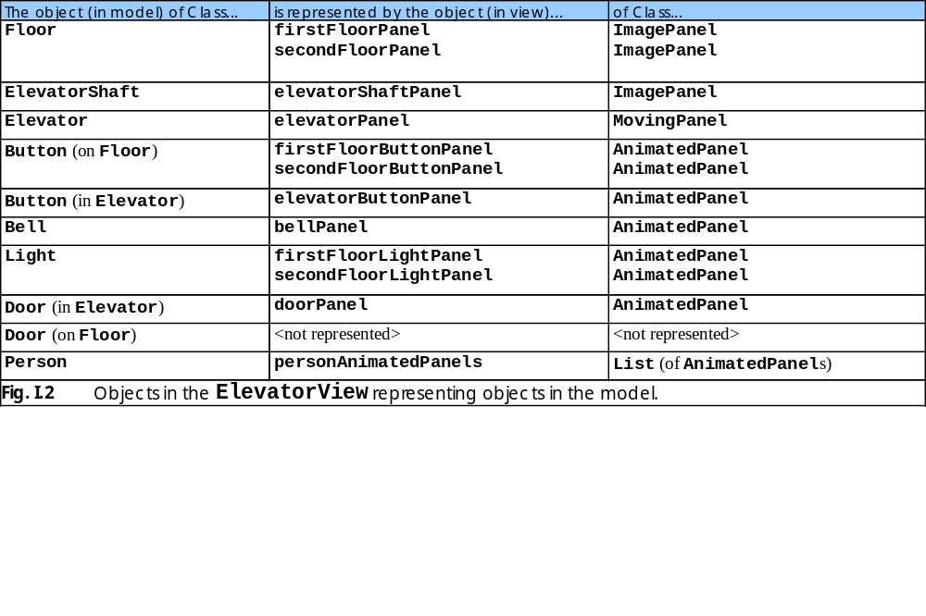
1.2 Class Objects (cont.)

Slide 32
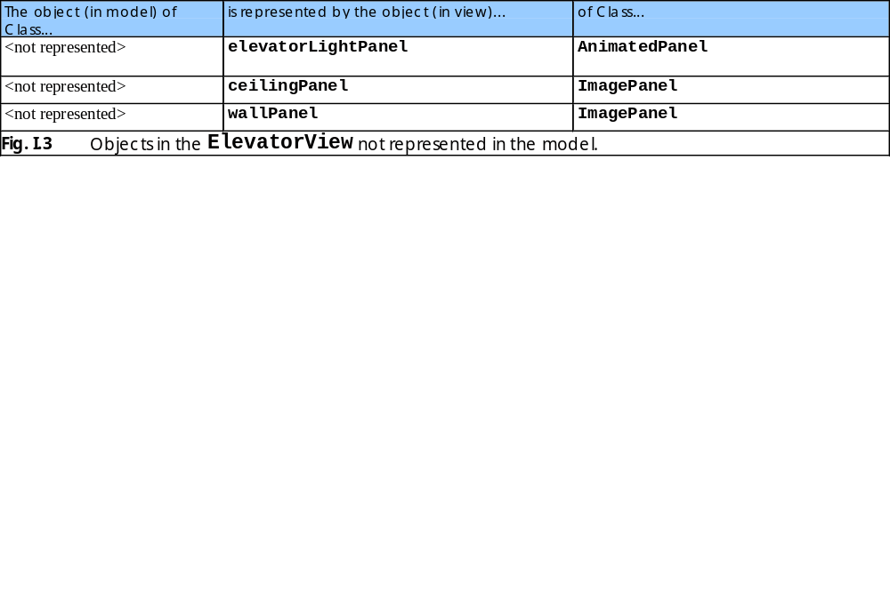
1.2 Class Objects (cont.)

Slide 33
I.3 Class Constants
Constants specify such information as:
  Initial placement of objects in ElevatorView
  Rate at which ElevatorView redraws screen
  Names of graphics and sound files
  Distance (in pixels) the ImagePanels representing Elevator and Person must travel
  Times needed to travel these distances

Slide 34
I.4 Class Constructor
ElevatorView constructor’s responsibilities:
  Instantiate ImagePanels (and ImagePanel subclasses)
  Add all ImagePanels to ElevatorView panel
  Initialize audio objects
  Compute initial velocity and distance traveled for Elevator’s associated ImagePanel
  Start animation Timer

Slide 35

1.4 Class Constructor (cont.)
Fig 1.4 Object diagram for the ElevatorView after initialization.

Slide 36
I.5 Event Handling
Event Handling in the view
  ElevatorView implements interface Elevator-ModelListener
    ElevatorModelListener inherits from all interfaces
    Therefore, ElevatorView must implement all interfaces
  ElevatorModel sends events to ElevatorView
    ElevatorSimulation registers ElevatorView for events from ElevatorModel

Slide 37
1.6 Component Diagrams Revisited
Component Diagram for view
  Package view contains six components (files)
    ElevatorView.java
      Aggregates (imports) packages images, sounds, events
    ImagePanel.java
    MovingPanel.java
    AnimatedPanel.java
    ElevatorMusic.java
    SoundEffects.java

Slide 38
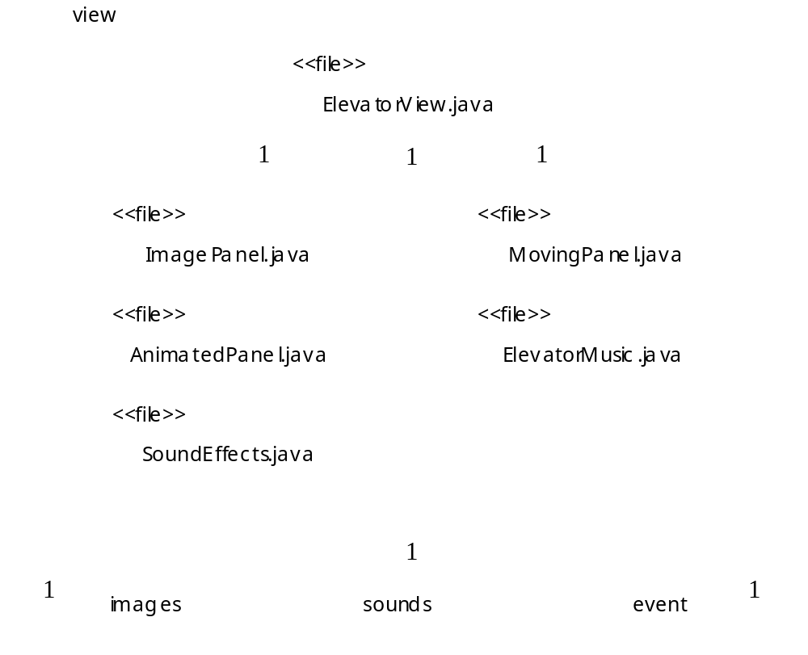
1.6 Component Diagrams Revisited (cont.)
Fig 1.5 Component diagram for package view.

